Slide 1
Fiqh of Ramadan
Part 1
By: Imām Azfar

Slide 2
Learning objective
Primary purpose of fasting
Why fast in Ramadan?
Linguistic definition of Ramadan
Why do we still commit sins?

Slide 3
Learning objective
Technical Definition
When should we encourage children to fast?
Difference between forgetting and mistake?
What is the key to fasting?

Slide 4
Learning objective
Do I have to know the rules of fasting?
Who must fast?
Moon-sighting vs calculations
What nullifies the fast?

Slide 5
Learning objective
What are the sunnah elements of fasting
What are the disliked elements of fasting
What is the difference between Qadā and Kaffarah?
When is Qadha necessary but not Kaffarah?
When is Qadha and Kaffarah necessary?

Slide 6
Learning objective
What breaks the fast?
What doesn’t break the fast?
Common questions about fasting
Q/A from community

Slide 7
What’s the primary purpose of fasting?
Obtain Taqwa

Slide 8
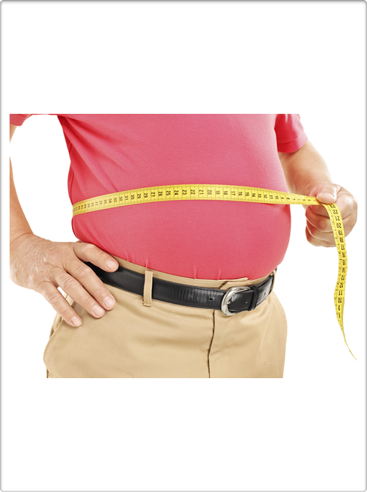
Secondary objectives of fasting could be…

Slide 9
https://www.mayoclinic.org/diseases-conditions/heart-disease/expert-answers/fasting-diet/faq-20058334

Slide 10
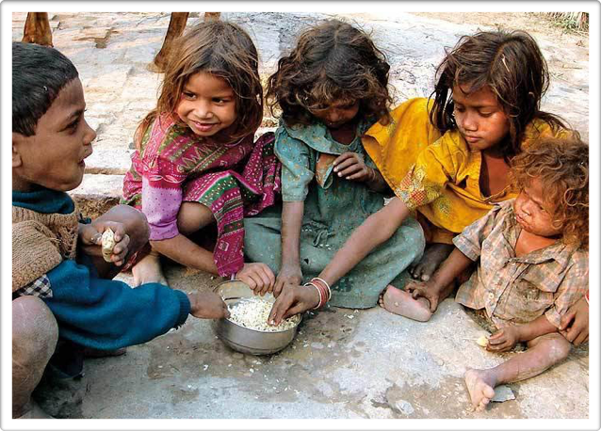
Secondary objectives of fasting could be…

Slide 11
Secondary objectives of fasting could be…
Self Control

Slide 12
Secondary objectives of fasting could be…
Extreme awareness of time

Slide 13
Why did Allah tell us to fast in Ramadan?

Slide 14
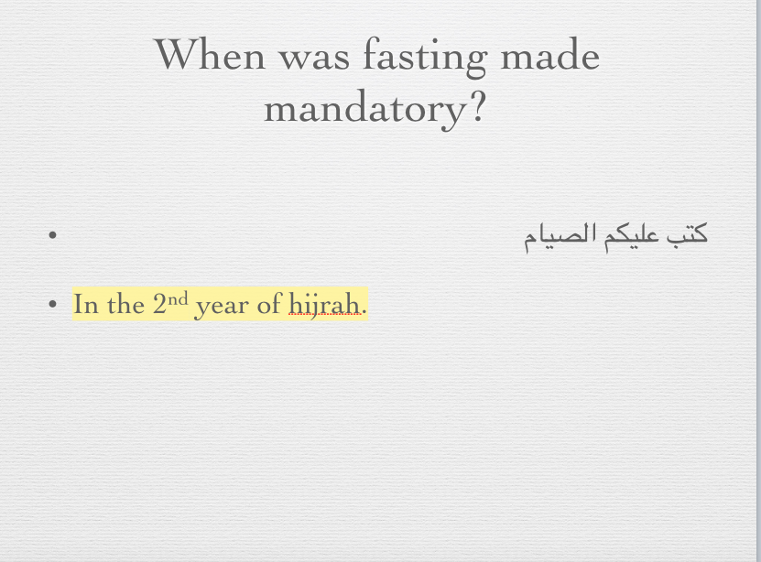

Slide 15
Literal meaning of Ramadan

Slide 16
رمض
The month of extreme heat burns the sins away with good deeds

Slide 17
إذا كان أول ليلة من شهر رمضان صفدت الشياطين ومردة الجن

Slide 18
So, why do we continue to sin?
Nafs
Other devils are not locked up
Bad habits take time to change

Slide 19
So, why do we continue to sin?

Slide 20
حقيقة الصوم
هو الإمساك نهارا عن إدخال شيء عمدا أو خطأ بطنا أو ماله حكم البطن وعن شهوة الفرج بنية من أهله
Fasting is to abstain during the day (true dawn until sunset) from allowing anything to enter into the stomach, whether intentionally or by mistake, or that, which has the same legal status of the stomach. Fasting is to abstain from sexual gratification along with the intention of fasting

Slide 21
When should children start fasting?

Slide 22
إن الله تجاوز لي عن أمتي الخطأ والنسيان وما استكرهوا عليه

Slide 23
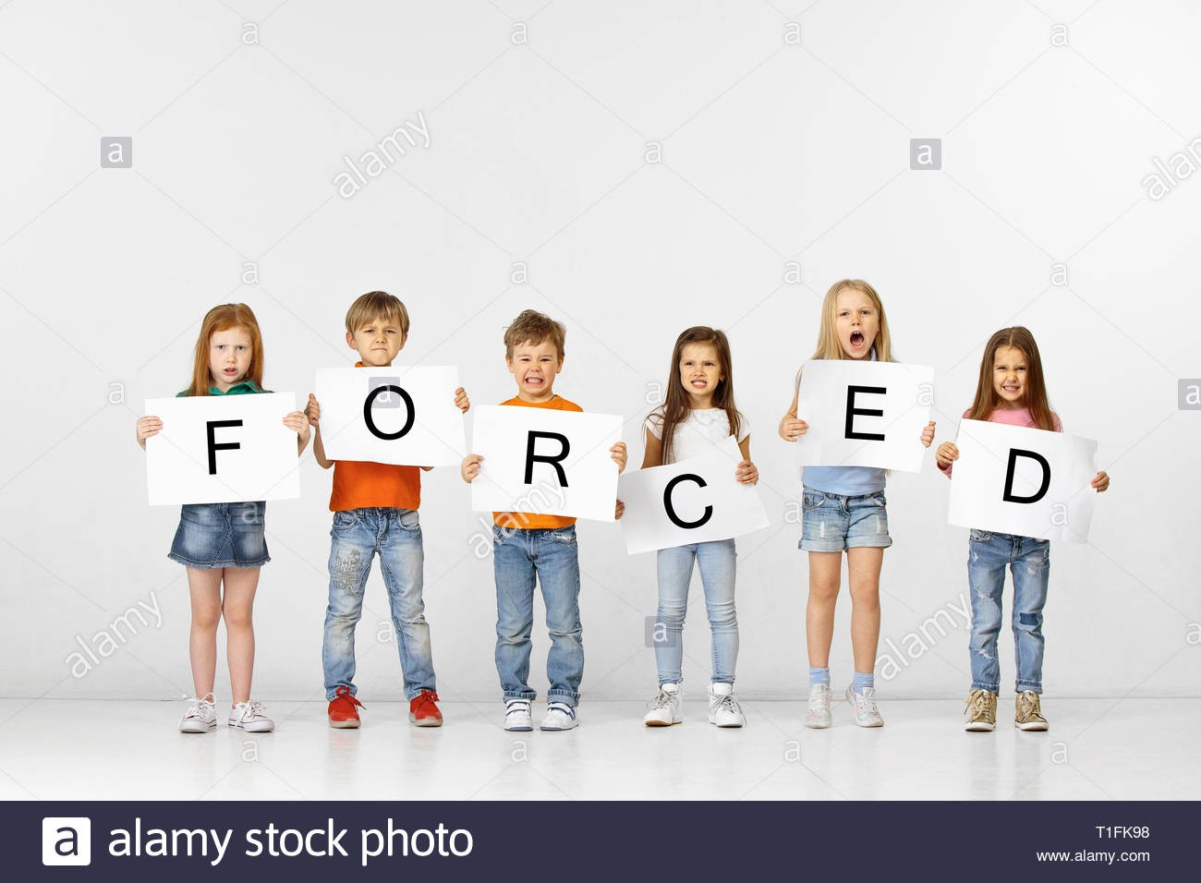
Allah has forgiven the ummah

Slide 24
Sincerity is key

Slide 25
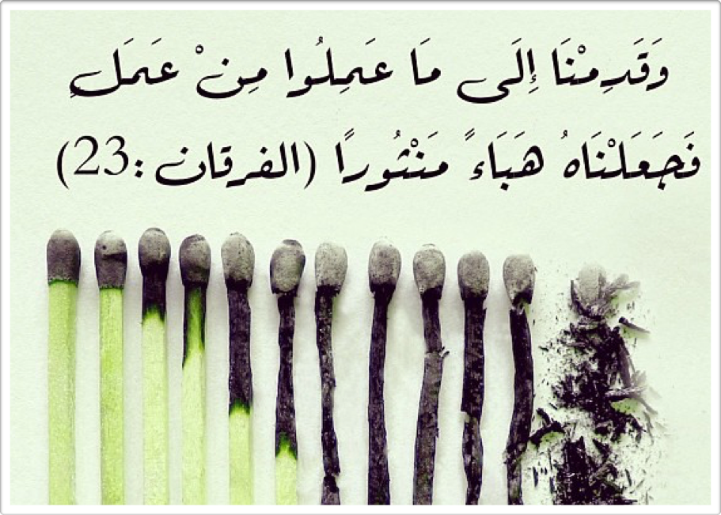

Slide 27
طلب العلم فريضة على كل مسلم
Not everyone has to be a scholar
If you are going to perform Umrah….
If you are going to fast…

Slide 28
Fasting is compulsory on
إسلام
والعقل
والبلوغ
الجسم

Slide 29
Mandatory upon every Muslim adult, male or female, who is both physically and mentally health and who is not a traveller

Slide 30
Conditions of Fasting
Intention to fast
Free from hayd (menstruation) and nifās (post-natal bleeding)

Slide 31
Intention
Necessary to make everyday
If you stay away from the nullifiers of the fast without an intention, the fast will be invalid.

Slide 32
Scenario
A Muslim prisoner abstained from food and drink from true dawn until sunset during Ramadan. He didn’t make the intention to fast because he didn’t know it was Ramadan. Does his fast count?

Slide 33
Scenario
Faisal woke up to partake in suhur. He forgot to make the intention. Will his fast be valid?

Slide 34
When can you make the intention?
From maghreb of the night before
Sara will fast on the 18th of May. She will make the intention on the 17th of May after Maghrib.

Slide 35
Until what time can you make the intention?
For the fast of Ramadan, one can make the intention until Dahwatul Kubra (midday)
For example, Fajr is at 4:00 AM. Maghreb is at 9pm.
Half the total time between Fajr and Maghreb is 8.5 hours.
Add the hours (8.5) to the beginning of Fajr.
Now you have the time for midday. In this scenario it is 12:30pm (4:00 AM + 8.5 hours = 12:30pm)

Slide 36
Fardh Elements of Fasting
Abstain from eating
Abstain from drinking
Sexual relations

Slide 37
What are the 3 nullifiers?

Slide 38
Sunnah Elements of Fasting
Suḥūr
To prolong the suhūr to the last part of the night
Immediate ifṭār
Intention to fast the next day before sleeping

Slide 39
Which acts are desirable (mustahabb):
while fasting?
To do as much good actions as possible
To reply to someone who is being toxic ‘I am fasting.’
Make du’a at the time of iftar
To break the fast with fresh dates if not then dried dates, if not, then with water.

Slide 40
Food Affects Your Spirituality
It may be halal, but will it negatively affect my spirituality?
Energy
Optimism

Slide 41
Behind the scenes: A naturopathic perspective on fasting
By Dr. Haque
April 19th.
7:45 - 8:30
Khalil Center

Slide 42
What foods should I eat in Ramadan?
https://www.youtube.com/watch?v=o1xvGuS_GYg
Muslim fitness expert and nurse.

Slide 43
Suhur recommendations by nutritionists
The meal should contain all the nutrients needed by the body (proteins, carbohydrates, vitamins and minerals) and have easily digestible foods so that it doesn’t cause any stomach discomfort.
“Proteins and fats take longer to break down.” - Dr. Haque
Avoid salty foods
Avoid fatty and fried foods which increase thirst.

Slide 44

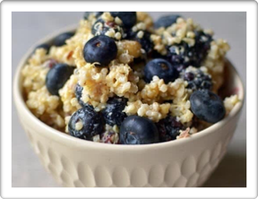
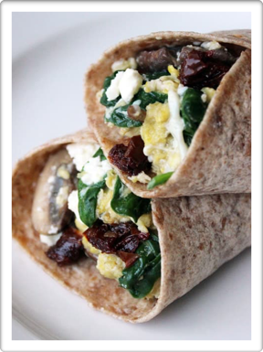

Slide 45
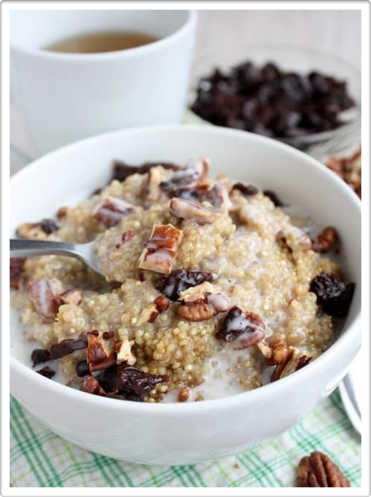
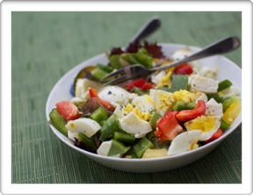


Slide 46
Make breakfast in advance

Slide 47
Iftar
“More caution and perhaps more restraint are necessary in breaking a fast than in keeping it.”
“Every fool can fast, but only the wise man knows how to break a fast.”

Slide 48
The iftar of Muhammad ﷺ
Fresh Dates
Dried dates
Water

Slide 49
Iftar
“Eat a salad, because it is rich in vitamins, minerals and fiber. It reduces your appetite and ensures you eat less of the main dish.”
“Have a smaller than usual dinner and fruits for desert” - Dr. Haque

Slide 50

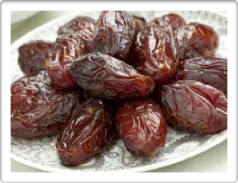

Slide 51
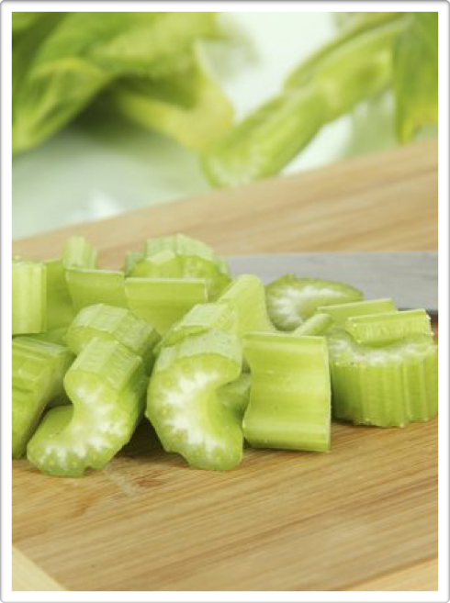
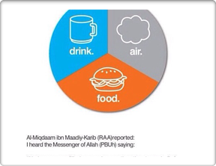


Slide 52
https://www.youtube.com/watch?v=eIqglSUUqm0
Start from 1:56 to 4:07
Benefits of bone broth

Slide 53
Exit slip
What was the most important lesson you learned?
How will you apply what you learned in your life?
Questions/Comments/Concerns?

Slide 54
Fiqh of Ramadan
Part 2

Slide 55
Game-plan
Review previous material
Qadha and Kaffarah
Common Questions

Slide 56
Qaḍāʾ and Kaffarah
Kaffārah is: two months consecutive fast with no break, or feeding sixty poor people.
Qadā’ is: making up missed fasts of Ramadān with similar number of fasts on days other than Ramadān.
Intentionally eating, drinking without an excuse, or having intercourse necessitates both qaḍāʾ and kaffārah.

Slide 57
What is Qadha?
Qadā’ : making up missed fasts of Ramadān with similar number of fasts on days other than Ramadān.

Slide 58
What is Kaffarah?
Kaffārah: two months consecutive fast with no break, or feeding sixty poor people.

Slide 59
When Kaffārah is not necessary, but Qaḍāʾ:
By breaking your fast mistakenly
Forced to break your fast
Pebbles or other non-food substance goes down throat (greater than a size of a chickpea)

Slide 60
When Kaffārah is not necessary, but Qaḍāʾ:
Intentionally swallowing vomit
Eat thinking it is still suhūr time when it is not
Eat out of forgetfulness. i.e. thought it broke his fast so started eating

Slide 61
Things that do not break the fast
Forgetfulness
Wet dreams
Rub lotion/oil on skin
Applying kuhl to eyes
Backbiting
Vomiting unintentionally
Kissing and caressing

Slide 62
Things that do not break the fast
Eating food lodged in one’s mouth (less than the size of a chickpea)
Chewing without swallowing (Non-Flavored gum)
Pouring water on oneself to cool the body
Beginning the fast in janābah
Using the miswāk (non-flavored)
Swallowing one's own saliva

Slide 63
Things that do not break the fast
Injections
IV’s (Difference of opinion)
Removal of blood
Blood tests for diabetes
Nose drops or eye drops
Swimming

Slide 64
Things that do not break the fast
Bathing while fasting
Nicotine patches
Emergence of madhi (pre-ejaculation fluid)
Gum bleeding
Putting water in eyes, ears, nose

Slide 65
Things that DO break the fast
Asthma pumps, inhalers (Difference of opinion)
Toothpaste entering the throat (Difference of opinion)
Smoking voluntarily
Self-induced ejaculation

Slide 66
Common questions

Slide 67
Why does nicotine patch not break the fast?
The fast is only nullified when a substance enters the body cavity through a recognized point of entry, such as the mouth, nose, or front and back private parts. Therefore, eye drops, injections, and nicotine patches do not break the fast as they do not enter the body from a recognized point of entry.

Slide 68
Why does using an inhaler break the fast?
The entrance of anything with a perceptible body into the body cavity through a recognized entrance, such as the mouth, would invalidate the fast. [Shurunbulal, Maraqi al-Falah]
If it is done due to a valid medical reason one would only be required to make-up that fast later on when one possesses the ability to do so.
If one suffers from chronic asthma, which requires usage of the spray or other medicine multiple times a day, then one would be excused from fasting and would be required to pay expiatory payments (fidya) instead

Slide 69
Can I brush my teeth when fasting?
Permissible to brush your teeth while fasting as long as you are very careful not to swallow any of it.
Ideal to use toothpaste right before starting your fast so that you can start your day with clean teeth.

Slide 70
Can one fast while traveling?
The traveling distance is: 48 miles.
If one travels more than 48 miles and stays at a location for less than 15 days, one would be considered a traveler

Slide 71
Scenario
Brother A is traveling to Spain in the month of Ramadan for 10 days and then traveling to London for 10 days and then France for 12 days. Does he have to fast?

Slide 72
“I’m traveling, do I have to fast?”
Ask yourself, "Do I really have to travel in the month of Ramadan?”
You may fast if you are able to.
If not possible, make it up. (Journey is difficult)

Slide 73
Valid excuses for missing the fast
Setting out on a journey (Definition of a traveller)
Temporary sickness
Pregnancy
Life-threatening hunger or thirst
Old age or weakness
Breastfeeding a child for fear of health of child or her own

Slide 74
I want to fast even though I’m pregnant
It is permissible for a woman not to fast if she fears some harm and that it will most likely affect her and/or her baby.
Every woman’s experience will be different.
Call her doctor (preferably both an practicing Muslim OBGYN and a non-Muslim medical opinion) to determine if it’s OK for her to fast during this time.

Slide 75
“I have to take meds at a certain time”
Speak with a practicing Muslim doctor
Base your judgement based on your past experience
If you feel there is a “reasonable chance” that fasting for so long will trigger manic episodes and depression, you should absolutely not fast
Make them up when the days are shorter
Health takes precedence

Slide 76
I’m old and can no longer fast.
Pay fidyah for missed fasts (Bukhari)
Feed one poor person with two meals for each day missed
$10 a day, or $300 a month

Slide 77
What if I accidentally inhale perfume?
Fast does not break
“One’s fast does not break by wearing, feeling or smelling fragrance. As such, it is permitted to apply perfume (itr), deodorant, or spays whilst in the state of fasting. However, if one was to intentionally inhale something that has a perceptible body, such as smoke, then one’s fast would become invalid.” (Mufti Ibn Adam)

Slide 78
Does using a nasal spray invalidate the fast?
Difference of opinion
Avoid swallowing anything that reaches the throat
One opinion is that it does invalidate the fast because it enters the body’s nasal cavity.

Slide 79
Eye drops?
Try to pour the eye drop correctly so that you don’t taste it
To prevent this gently press on the tear duct for a minute or so after applying the drop. This will also help prevent any of the eye medication getting into the rest of your system,

Slide 80
Is taking a meal before commencing a fast (suhur) necessary in order for a fast to be valid?

Slide 81
Can a man have sexual intercourse with his wife during the nights of Ramadhan?
Stop before the break of dawn

Slide 82
Why does Allah say to fast until the “layl”? Doesn’t it mean night?
No contradiction
The beginning of the night is sunset, and the end of the night is when dawn comes.
إِذَا أَقْبَلَ اللَّيْلُ ، وَأَدْبَرَ النَّهَارُ ، وَغَابَتْ الشَّمْسُ ، فَقَدْ أَفْطَرَ الصَّائِمُ

Slide 83
Is it permissible to kiss and caress one’s wife whilst fasting?
كَانَ رَسُولُ اللَّهِ صلى الله عليه وسلم يُقَبِّلُنِي وَهُوَ صَائِمٌ وَأَنَا صَائِمَةٌ
If one feels sure that it will not lead to intercourse or ejaculation else then it is in itself permitted.
If one fears that kissing will lead to ejaculation or intercourse, then it will be disliked to kiss
One’s fast remains valid as long as kissing does not lead to actual sexual intercourse or does not result in ejaculation.
If kissing resulted in ejaculation, one’s fast would become invalid and hence will have to be made up (qadha), without having to expiate for it (kaffara)

Slide 84
Does vomiting break the fast?
Unintentional - mouthful - intentionally swallowed
Intentional - mouthful irrespective of whether it is swallowed or not.
Not broken by non-deliberate vomiting
Not broken by vomiting intentionally less than a mouthful.

Slide 85
What if I’m becoming pregnant every other year? Do I have to make up the fasts?
Does not have to do so immediately but gradually when one is able to do so without burdening oneself excessively.

Slide 86
Am I considered “dirty” while menstruating?
“I would drink while menstruating, then pass the vessel to the Prophet (Allah bless him and give him peace). He would place his mouth on the (same) place as my mouth and drink….” [Muslim]
Not dirty, ritually impure
Legal consequences and not spiritual consequences.

Slide 87
“No one should touch the Qur’an except one who is taahir (ritually pure).”
The Quran is revelation
“Etiquette with the Qur’an" by Imam al-Nawawi. Translated by Musa Furber

Slide 88
Menstruation Is Not A Punishment

Slide 89
What acts can I do when I’m menstruating?

Slide 90
1) Listening to the Qur’an

Slide 91
2) Listening to beneficial lectures

Slide 92
3) Dhikr

Slide 93
4) Send blessings upon the Prophet (upon him be peace)

Slide 94
5) Charity

Slide 95
6) Du’a

Slide 96
7) Feed the fasting people

Slide 97
“Though these acts may seem simplistic, they are heavy in the eyes of Allah”
–Imam Azfar Uddin

Slide 98
Fiqh of Ramadan
Part 3

Slide 99
Game-plan
Review previous material
Ethics of disagreement
8 rak'ah vs 20 rak’ah
How can I pray tarawih at home?
Moon-sighting vs calculations
15 degrees Fajr vs 18 degrees Fajr
Specific du’as for Ramadan
Common questions

Slide 100
Ethics of disagreement
Islam has allowed valid differences (ikhtilaf) but it has prohibited division (tafarruq). Why?
Statement of Ibn Abi Jamrah
Story of Imam al-Zuhri
Story of Imam al-Shafi
Story of Imam Ahmed ibn Hanbal

Slide 101
Ethics of disagreement
Have a sincere intention. Why?
Be trained in several sciences before debating
Scholars are in agreement in vast majority of issues related to worship
Disagree like Abu Bakr and Umar would disagree

Slide 103
Tarawih, 8 vs 20
The tarawih prayer is sunna mu’akkada

Slide 104
Unity
“Whoever prays with the imam until he finishes, Allah will record for him as if he spent the whole night in prayer” (Hadith)
There is no dispute amongst the scholars that the established sunnah of taraweeh is to pray in congregation and finish with the Imam, whether he prays 8, 20 or 36 Rakaat.

Slide 105
Argument for 8 Rak’ah
How did the Messenger of Allāh (peace and blessings of Allāh be upon him) pray during Ramadān?” She said: “He did not pray more than eleven rak’ahs in Ramadān or at other times.(al-Bukhaari, 1909; Muslim, 738)

Slide 106
Argument for 20
“Do you pray tarawih outside of Ramadan?”
A’isha (may Allah be pleased with her) wasn’t referring to the tarawih prayers
There is a difference between Tahajjud and Tarawih

Slide 107


Tarawih | Tahajjud
Prayed in the final year | Ordained in the beginning of Islam
Beginning of the night | Last part of the night
Collectively | Individually
In the masjid | At home
In Ramadan | In Ramadan and outside of Ramadan

Slide 108
Shouldn’t we follow what Muhammad ﷺ did instead of Umar if there’s a conflict?
Definition of sunnah is…
“You must adhere to my sunnah and the sunnah of the Rightly-Guided Caliphs who come after me” (Abu Dawud and al-Tirmidhi)
It is 20 raka’ahs, proven from the unanimous consensus of the Sahaba.

Slide 109
At the same time…
Don’t judge those who pray 8
More important than the number is …

Slide 110
Quality over quantity
How did the Messenger of Allāh (peace and blessings of Allāh be upon him) pray during Ramadān?” She said: “He did not pray more than eleven rak’ahs in Ramadān or at other times. He would pray four, and do not ask how beautiful and long they were, then he would pray four, and do not ask how beautiful and long they were, then he would pray three. I said, ‘O Messenger of Allāh, will you sleep before you pray Witr?’ He said, ‘O ‘A’ishah, my eyes sleep but my heart does not.(al-Bukhaari, 1909; Muslim, 738)

Slide 111
Leave the masjid quietly if you’re leaving after 8

Slide 112
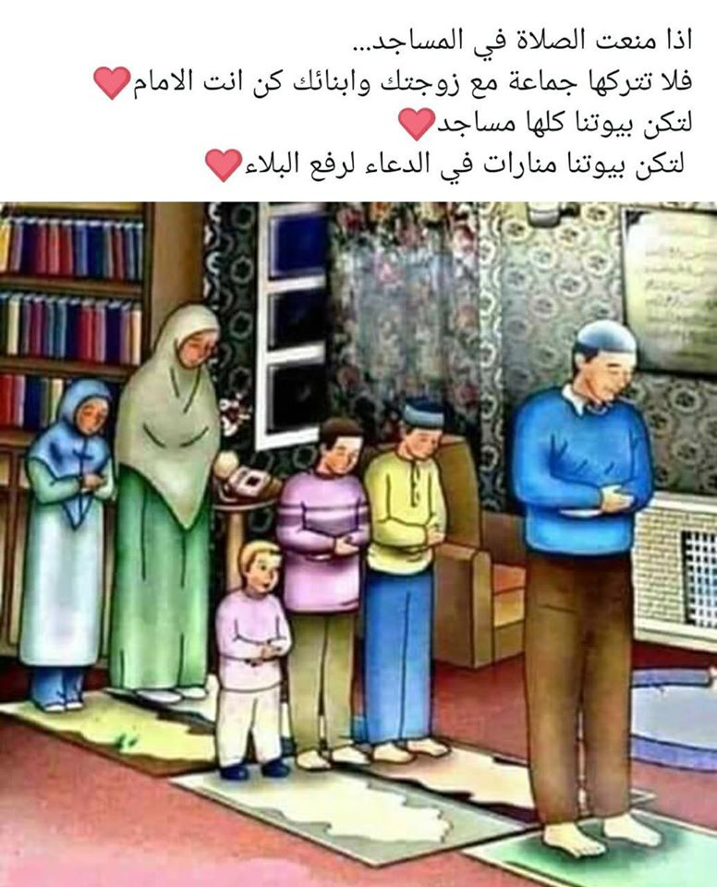

Slide 113
How can I pray tarawih at home?
Dedicate a clean and comfortable space for prayer in your home.
Set a time to pray ʿIshā’ nightly.
Give the adhān, iqāmah, and pray with those at home with you in congregation. If you live by yourself or are the only Muslim in your household still give the adhān and iqāmah as you will be leading a noble congregation of Angels.
Recite the adhkār after prayer and make duʿā’.

Slide 114
How can I pray tarawih at home?
5. Pray the two emphasized units of sunnah prayer after ʿIshā’.
6. Pray tarāwīḥ as you would in the masjid with anywhere from 8-20 units. In these units you can recite however much Quran you know from memory.

Slide 115
How can I pray tarawih at home?
7. Before the salah, engage with whatever portion of the Quran you are reciting by reading the translation, commentary (tafsīr), and reflecting upon the meanings.
8. Pray Witr.
9. Remove distractions

Slide 116
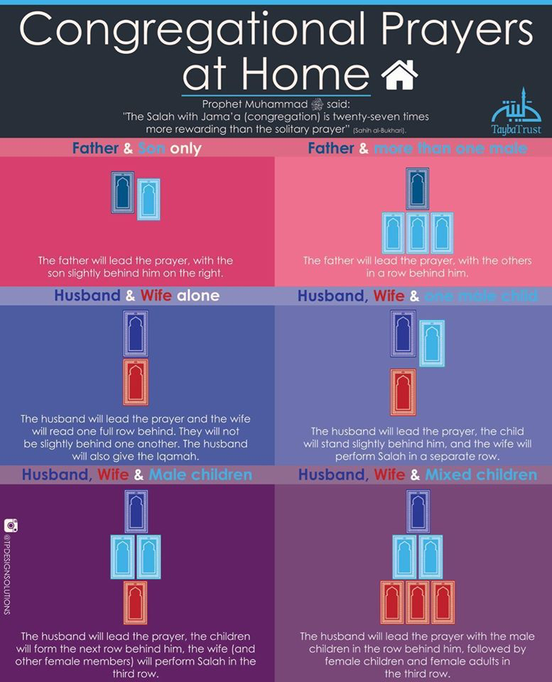

Slide 117
Can I pray tarāwīḥ while reading from the muṣḥaf?
Not allowed during obligatory prayers
Difference of opinion in voluntary prayers.

Slide 118
Pros | Cons
Complete a recitation of the Qur’an by reciting one juz’ a night | You can complete the recitation of the Qur’an outside of tarawih
Longer qiyam | Reading from a muṣḥaf entails excessive movement (ʿaml kathīr)
More concentration since you're reading different surahs | Potential impact on society, people may say, “Why do I need to become hafiz when I can just read from the mushaf”
 | God says, “Read whatever is easy for you”
 | The Prophet ﷺ did not pray in this manner

Slide 119
My recommendation
The prayer of Muhammad ﷺ did not involve using a mushaf. Read whatever is easy for you in the tarawih prayers. Outside of the prayers, complete the recitation of the Qur’an.

Slide 121
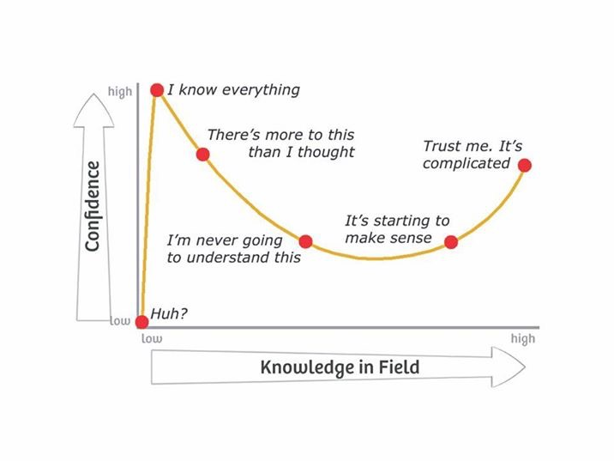

Slide 122
If you want to debate about the moon sighting issue then you better…
Be properly trained in fiqh
Be properly trained in its usul
Know when one can use ijtihad
Have sound knowledge of astronomy
Well-versed in both observational and theoretical astronomy
Study the evidence for all the different sides

Slide 123
Several positions on moon sighting
Local Sighting
Sighting anywhere in North America
A physical sighting anywhere globally
Calculated sighting
Following Saudi Arabia specifically/or calling family members who reside in Muslim countries (Not mentioned in the books of Fiqh)

Slide 124
If you want to debate about the moonlighting issue then you better realize that
“The early scholars who did allow calculations did not advocate calculation as a method in which we bypass sighting altogether and examine what they said objectively” (Shaykh Hamza Yusuf)

Slide 125
If you want to debate about the moonlighting issue then you better realize that
“Each of the schools did not allow calculation in lieu of actual sighting; all of them stipulate that one can resort to calculation only if, on the thirtieth night, there is a cloud-cover that prevents seeing the crescent and astronomers have indicated that the moon would be visible” (Shaykh Hamza Yusuf)

Slide 126
“If the hilal is obscured [on the thirtieth day at sunset], then it can be reckoned with the mansions of the moon, i.e., which mansion it was in when it was obscured, or by way of calculation (hisab)” - Mutarrif b. Abd Allah

Slide 127
The crux of the issue
The Shari`ah did not bind the issue of fasting to the birth of the crescent moon, but rather to it being seen

Slide 128
Only two definitive methods?
The fast becomes mandatory either by:
1) Sighting the new moon by the naked eye
2) Passing of thirty days of Shaʿbān

Slide 129
ISNA’s Position
The Qur’an never required physical moon sighting but asked for “witnessing the month.”
Different interpretation of the verse, “Whoever witnessed the month.”
“It means, whoever is present in his residential place and gets to know about Ramadan’s arrival through any kind of knowledge, including sighting but not confined to sighting.”

Slide 130
ISNA is working with its Fiqh Council and highly qualified mathematicians and astronomers
Rely on calculation in order to facilitate the start dates for people’s scheduling concerns
Help the community gain recognition from the government for Muslim holidays
Muslim unity

Slide 131
ISNA’s Position
Scholars of the earliest period have accepted calculations as well as others of the later period
“And if the crescent moon is obscured, then determine it.”
“Complete its number.” This is why the Prophet ﷺ said in [another narration], “complete the number of days of Sha’ban, thirty days.”

Slide 132
Fiqh Council of North America
“Scientific method is more trustworthy than the human efforts at observing the moon with naked human eyes.”
“There is nothing wrong in accepting the birth of the new moon as the convention to start the new month, not the actual sighting of the moon.”
“Astronomical science is highly developed and visibility charts can be generated to high degrees of precision.”

Slide 133
Fiqh Council of North America
“At the time of Prophet ﷺ and later centuries, actual moon sighting was the most authentic way of attaining the certainty. We in the modern times can reach the same goal through precisely accurate astronomical calculations. Scientifically computed astronomical calculations were not available during the Prophetic times.”

Slide 134
My statement
“If you want to debate about the moon-sighting issue then you better be properly trained in fiqh and in its usul, have sound knowledge of astronomy, and study the evidence for all the different sides. After studying the evidence for all the different sides, I came to the conclusion that moon-sighting is the strongest opinion. That being said, this issue is a valid difference of opinion amongst the scholars. After looking at the history and situation of my community and keeping the best interests of the community in mind (We are trying to help the community gain recognition from the government and Public Schools nearby for Muslim holidays), I come to the conclusion that we can continue to follow calculations, but shouldn’t neglect moon-sighting as well. Trusting an authority and following his opinion is permissible in Islamic Law, however debating over legal issues when one is not qualified is prohibited.”

Slide 135
Resources on this issue
Cesarean Moon Births, By: Shaykh Hamza Yusuf
An Islamic Legal Analysis of the Astronomical Determination of the Beginning of Ramadan, By: Shaykh Mokhtar Maghraoui

Slide 136
Resources on this issue
The Astronomical Calculations and Ramadan A Fiqhi Discourse, By: Dr. Zulfiqar Ali Shah
The Journal of Insights Through Reflections On Nature, by: Dr. Youssef Ismail

Slide 138
History, condition of the people
Muhammad ﷺ was involved with a well-known story about setting the Black Stone in place in the wall of the Kaaba in 605 CE. The Black Stone, a sacred object, had been removed to facilitate renovations to the Kaaba. The leaders of Mecca could not agree on which clan should have the honor of setting the Black Stone back in its place. They agreed to wait for the next man to come through the gate and ask him to choose. That man was Muhammad ﷺ. He asked for a cloth and put the Black Stone in its center. The clan leaders held the corners of the cloth and together carried the Black Stone to the right spot; then Muhammad ﷺ set the stone in place, satisfying all who were present. (Ibn Ishaq)

Slide 139
“Notice, Muhammad ﷺ didn’t say “We need to get rid of the idols immediately” He looked at the current condition of the people and addressed the situation that they were dealing with at the time”
–Imam Azfar

Slide 140
Why do some people in Chicago start their fast earlier?
Valid difference of opinion
ISNA - 15 degrees
Other Fiqh councils - 18 degrees
Earlier time for Fajr seems to be the majority opinion
(Approximately 20 minute difference)

Slide 141
“If one of you hears the call (to prayer) and the vessel is still in his hand, let him not put it down until he finished with it” (Abu Dawood)(Sahih)
There used to be two azān given during the time of the Prophet ﷺ
10 minutes before Fajr (Tahajjud)(Recommended time to stop eating)
Another azān at the time of Fajr
Eating during Fajr time invalidates the fast

Slide 142
إِنَّ بِلالا يُؤَذِّنُ بِلَيْلٍ ، فَكُلُوا وَاشْرَبُوا حَتَّى يُؤَذِّنَ ابْنُ أُمِّ مَكْتُومٍ ( رواه البخاري ومسلم)

Slide 143
Can I fast in Shawaal with the intention of doing the 6 fasts while making up the fasts from Ramadan ?
Permissible but the primary intention is of making-up the missed fasts.

Slide 144
I’m a doctor treating CO-Vid 19 patients, do I have to fast?
Carefully consider all the alternative options
Attempt to fast if they are able to
If they struggle, they can break the fast and repeat at a later date
Those who are unable to fast due to the strong likelihood of dehydration, severe thirst due to wearing PPE, along with the risk of making clinical errors which could potentially affect lives, the fasts can be postponed to a later date.

Slide 145
What to say before breaking the fast
اللهم إنى لك صمت وبك آمنت وعليك توكلت وعلى رزقك أفطرت

Slide 146
What to say after breaking the fast
ذَهَبَ الظَّمَأُ وَ ابْتَلَّتِ الْعُرُوقُ، وَ ثَبَتَ الأجْرُ إنْ شَاءَ اللَّهُ

Slide 147
Praying Eid at home
The theme of celebration should be obvious in our homes and heart (decorate and express joy)
The local Imam give a live reminder that can be streamed at homes at a time that suits the local community’s needs.
People can pray 2 Rakat in their homes together
Share gifts.

Slide 148
Recap
Review previous material
Ethics of disagreement
8 rak'ah vs 20 rak’ah
How can I pray tarawih at home?
Moon-sighting vs calculations
15 degrees Fajr vs 18 degrees Fajr
Specific du’as for Ramadan
Common questions

Slide 149
Any Q/A?

Slide 150
How can I get the best out of this Ramadan
Bonus session

Slide 151
Fill in the blank
This Ramadan is going to be_________________

Slide 153
Which mindset do you have?
FIXED | GROWTH
No communal tarawih = no spiritual growth | No communal tarawih = more time to focus on individual ibadah
I wanted to hear Qari Osman’s voice | Let me improve my own recitation
I give up | Let me use a different strategy
I failed, I’m worthless | I failed, but I gained knowledge and experience
This is too hard | Let me take some time
I can’t believe she said that about me | I can’t control what others say about me

Slide 154
Which mindset do you have?
FIXED | GROWTH
Plan A didn't work | Let’s go to Plan B
Plan B didn’t even work | Let's go to Plan C
I don’t like to be challenged | Challenges help me grow
I will take this feedback personal | Something to learn from
I’ll stick to what I know | I like to try new things
If you succeed I feel threatened | I am inspired by the success of others

Slide 155
“A sign that your Ramadan was accepted is that you improved in one way.”
–Imam Azfar Uddin

Slide 156
What Is One Trait That You Want To Change About Yourself?

Slide 157
The following are goals listed by various participants

Slide 158
Goals in Ramadan
Be moderate in my food intake
Give a dollar a day
Memorize one line a day.
Strengthen ties with toxic family members

Slide 159
Goals in Ramadan
Be able to make du’a for more than 5 minutes at one sitting
I won’t binge watch on Tiktok
I will read 5 minutes of Qur’an a day
Forgive everyone who has hurt me

Slide 160
Goals in Ramadan
Listen to 5 minutes of Qur’an everyday
Perform I’tekaf
Finish the recitation of the Qur’an by myself

Slide 161


Slide 162
Create your own customized goals

Slide 164
Specific | What exactly do I want to happen
Measurable | I know I will reach my goals when…
Attainable | With hard work is it possible to achieve this goal by the deadline?
Realistic and Relevant | My goal is important enough to me to put a plan into action
Time bound | I will reach my goal by

Slide 165
https://www.scholastic.com/content/dam/teachers/blogs/genia-connell/migrated-files/smart_goal_planner.pdf

Slide 166
Work on your SMART goals for the next 3 minutes
Brave participants share their goals
Next month - Review your goals
Any questions/comments/concerns?

Slide 167
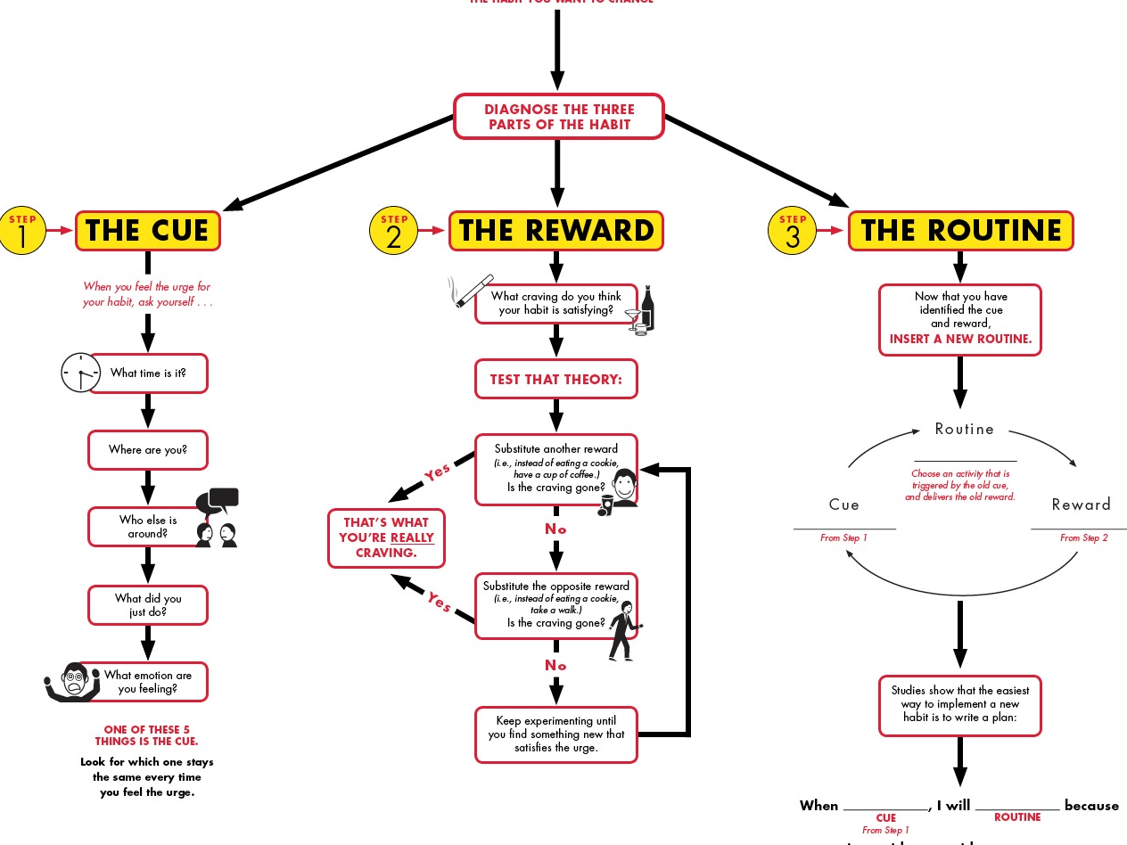

Slide 168
Please fill out exit slip
What was the most important thing you learned
Any questions?
Any feedback?

